Slide 1





















SwarmGenomics Mitogenome assembly and NUMTs
ATGCTTCGCGAACGTACGTCGCGAACATTATGCTTCGCGAACGTACGTACGTAGGT

Slide 2
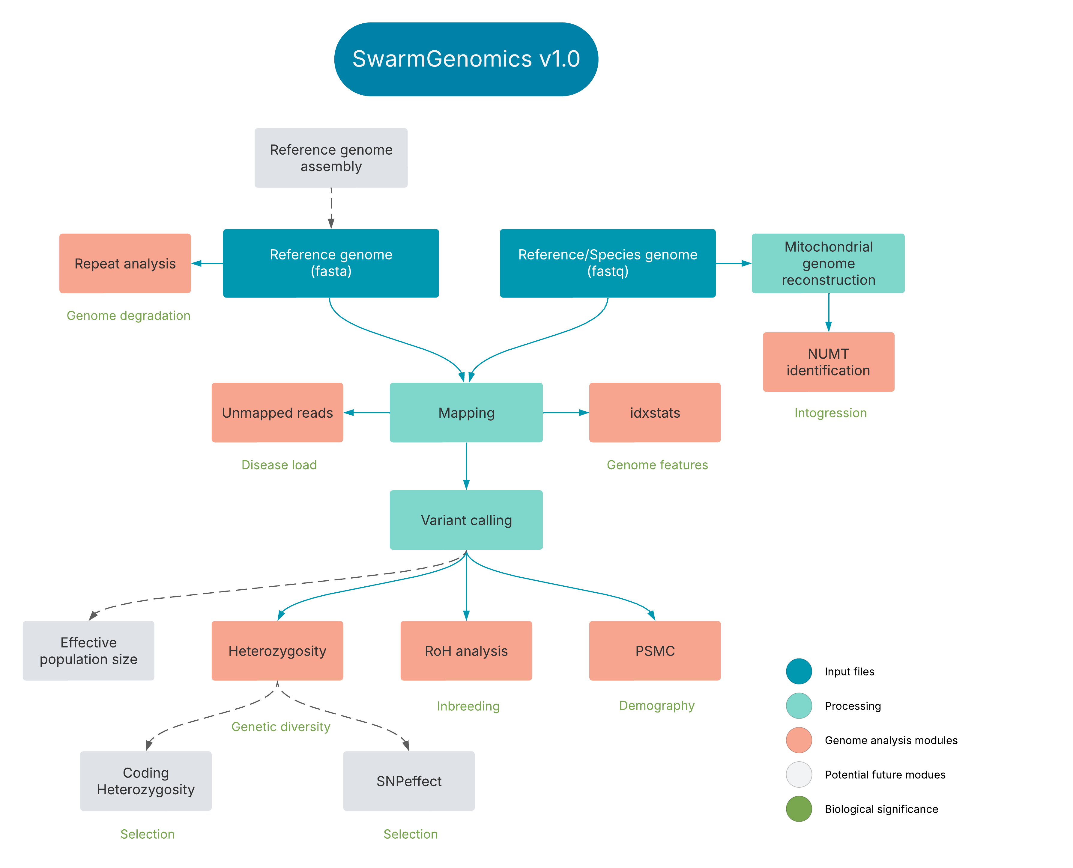

Slide 3
Mitogenome
Circular DNA molecule, typically 15–20 kb in animals
High copy number in cells
Lacks introns (in most animals), and usually shows maternal inheritance

Slide 4
Why Study Mitogenomes?
Useful for phylogenetics, population genetics, and species identification (e.g., DNA barcoding)
Higher mutation rate than nuclear DNA → sensitive marker for recent evolutionary events

Slide 5
Common Challenges in Assembly
Short reads: Can't span repetitive regions → fragmented assemblies.
Circularity: Must identify overlap to circularize.
NUMTs: Nuclear mitochondrial DNA segments that mimic mitochondrial sequences.
Heteroplasmy (coexistence of multiple mtDNA variants in a single individual).

Slide 6
NUMTs - Nuclear Mitochondrial DNA Segments
Segments of mtDNA that have been inserted into the nuclear genome
Continuous, on-going and non-random random process found across species and tissues
Fragments can introgress from closely related species through hybridization or interbreeding
Can be preserved in ancestral state

Slide 7
Why Study NUMTs?
Molecular fossils
Comparing NUMTs to current mtDNA can reveal:
Past mitochondrial haplotypes
Evolutionary events like selective sweeps or mtDNA lineage replacements
Timing of insertions (using molecular clocks or flanking nuclear divergence)
NUMTs as Markers of Species and Population Divergence
Species differ in:
NUMT number
NUMT locations and sequences
This variation can be used for:
Phylogenetic inference
Tracing hybridization or introgression events

Slide 8
08. Mitochondrial Genome Reconstruction
https://github.com/AureKylmanen/Swarmgenomics/blob/main/08.%20Mitochondrial%20Genome%20Reconstruction.md
The mitogenome assembly uses GetOrganelle
De novo assembly of organelle genomes from raw sequencing reads

Slide 9
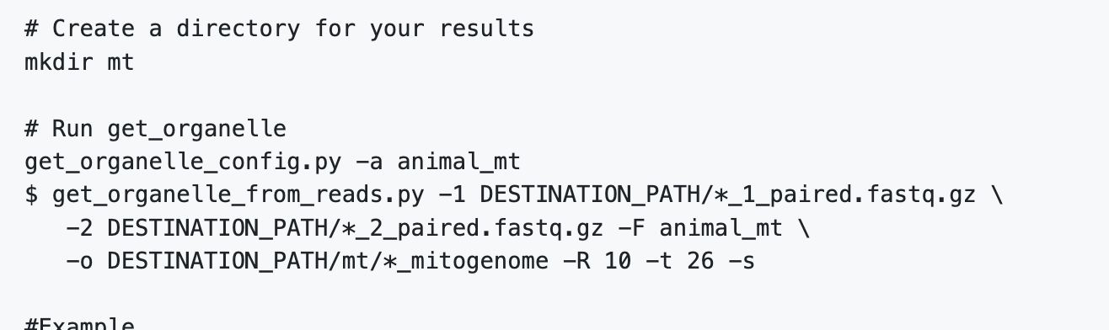
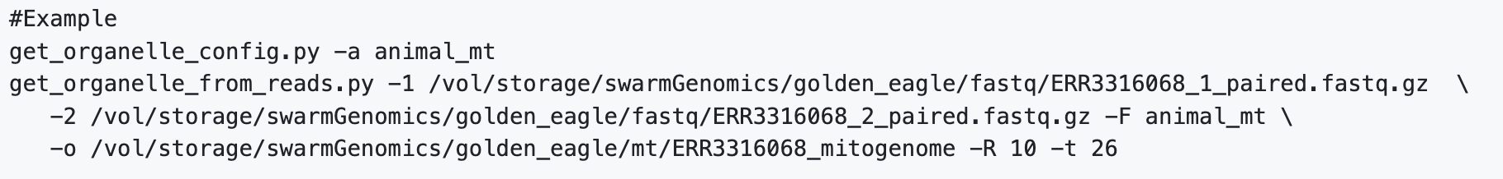
08. Mitochondrial Genome Reconstruction
_paired.fastq.gz files from your fastq directory
output directory and file name accordingly
Change number of threads accordingly

Slide 10
08. Mitochondrial Genome Reconstruction
Output should be:
*.path_sequence.fasta, each fasta file represents one type of genome structure
*.fastg, the organelle related assembly graph to report for improvement and debug
*.selected_graph.gfa, the organelle-only assembly graph
get_org.log.txt, the log file

Slide 11
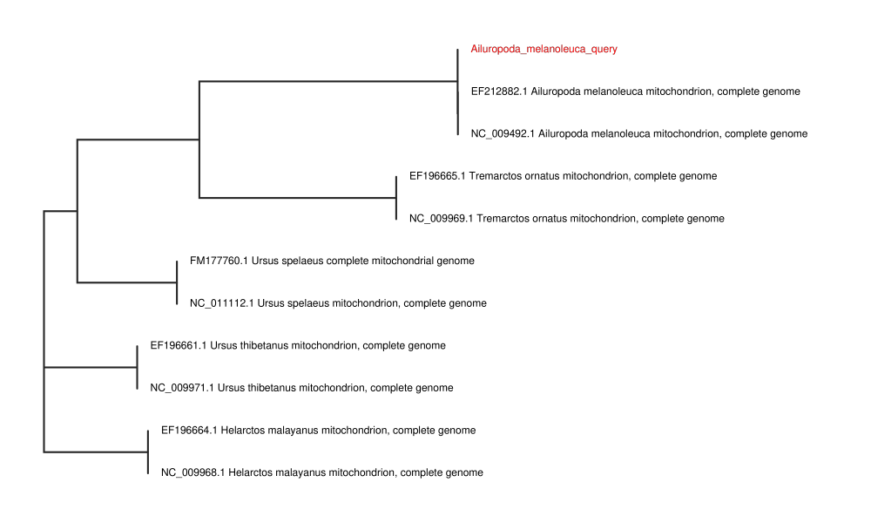
08. Mitochondrial Genome Reconstruction
Plotting a phylogenetic tree
Purpose:
Place your generated mitogenome in a phylogenetic context
Compare against reference mitochondrial genomes to confirm your species
Tree helps visualize evolutionary relationships and validate your sample identity

Slide 12
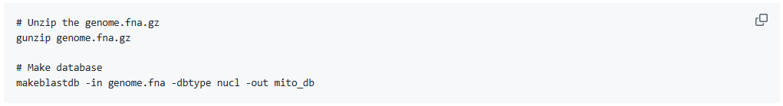
08. Mitochondrial Genome Reconstruction
Prepare mitogenome database (download the file with mitogenomes through a link on GitHub)

Slide 13
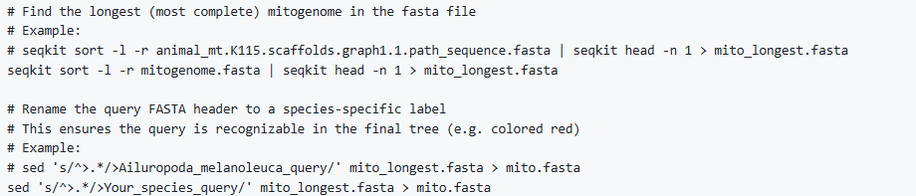
08. Mitochondrial Genome Reconstruction
2. Prepare Your Query Sequence
Change the mitogenome.fasta to the reconstructed mitogenome from getorganelle
E.g. animal_mt.K115.scaffolds.graph1.1.path_sequence.fasta
Rename the Fasta header according to your species

Slide 14
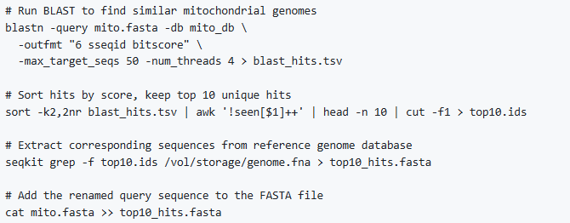
08. Mitochondrial Genome Reconstruction
3. Identify Similar Mitochondrial Genomes

Slide 15

08. Mitochondrial Genome Reconstruction
4. Align and Build Tree
5. Plot the tree
Download phylotree.py script from GitHub

Slide 16
09. NUMT Identification
https://github.com/AureKylmanen/Swarmgenomics/blob/main/09.%20NUMT%20Identification.md

Slide 17

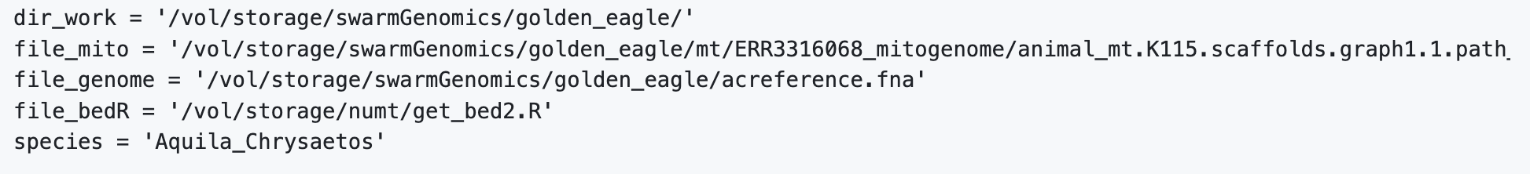
09. NUMT Identification
Active python
Edit the paths of the python script on a text editor
File_mito is in your mt directory and should be something like: animal_mt.K115.scaffolds.graph1.1.path_sequence.fasta
Download get_bed2.R from GitHub

Slide 18
09. NUMT Identification
Paste the full script on terminal to run (except the exit at the end)
Once finished, exit python with:
exit()
The NUMTs are in species_name.sep.fa and you can find out how many there are with:
grep -o ">" /vol/storage/swarmGenomics/golden_eagle/Aquila_Chrysaetos.sep.fa | wc -l

